Slide 1

Lambda Function

Slide 2
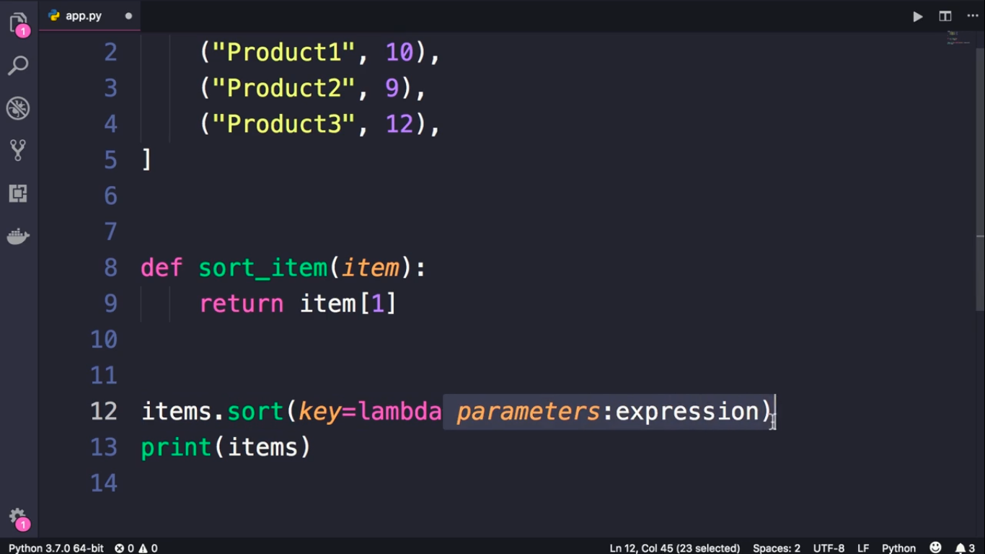

Slide 3
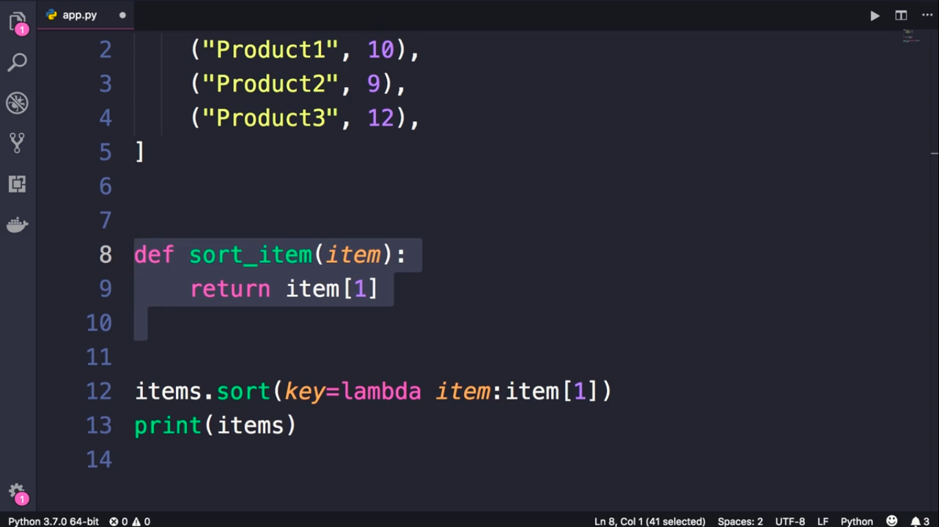

Slide 4
